Slide 1
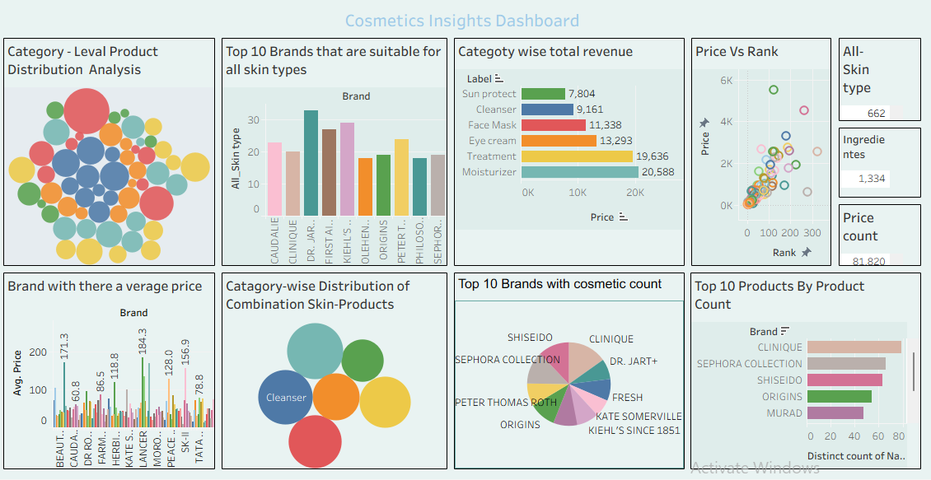
Assignment-3

Slide 2
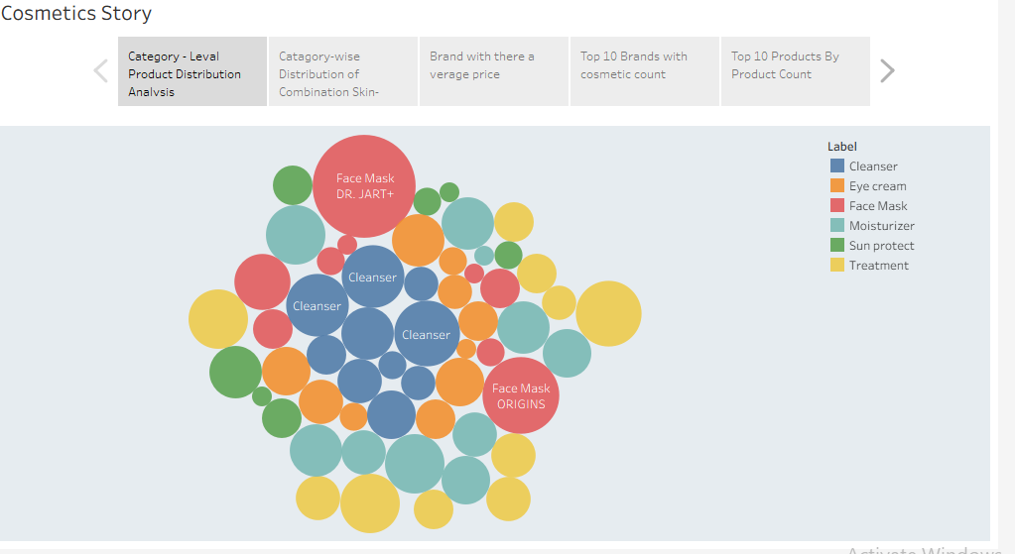

Slide 3
Lakshmi Parvathi Desireddy
Vignan’s Nirula Institute Of Technology And Science For Women

